Slide 1
WARM UP TALK
What is the most unforgettable moment in your life?

Slide 2
Write down your storytelling transcript in the Microsoft words about a travelling experience, an unforgettable experience, your Dinus Inside experience or moments which happened in past.
Concern on applying past tense.
Minimum more than 100 words or make sure that the text will show about 3 minutes of duration.

Slide 3
Listening Section
COMPREHENSION AND PHOTOGRAPH

Slide 4

A Phone Call from a Customer
listen to the audio and do the exercise. Write the sentences in the correct group.
Let me see what I can do | I promise this won’t become the norm.
I’m happy to help you. | I’m not sure if I can do that.
You’ll really be helping us. | I appreciate your help.
I need a favour. | I think we can make an exception this time.
The customer says: | The supplier says:

Slide 5

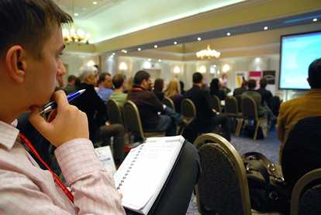
In each question, you will look at a photograph and then listen to 4 sentences. Choose the sentence that best describes the photograph.

Slide 6
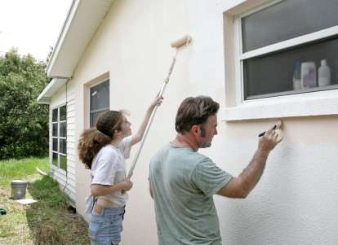
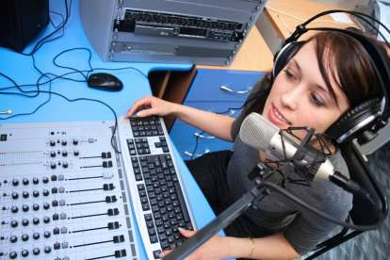

Slide 7


